Slide 1
1926 Construction
Hoists and Elevators

Slide 2
Construction false cars and running/working platforms
Hoists and Elevators

Slide 3
There is some discussion in the conveyance industry regarding false cars and running/working platforms being classified as suspended scaffolds.
Hoists and Elevators
There is not much difference between the industry safety practices we use and the OSHA regulations regarding safety while working from these conveyances.
During this presentation, we will reference industry practices as well as applicable OSHA standards for false cars, running/working platforms, and suspended scaffolds.

Slide 4
False cars and running/working platforms
Hoists and Elevators
Objectives
Identify false cars and running/work platforms
Describe types of common safety hazards
Apply safety hazard protection methods

Slide 5
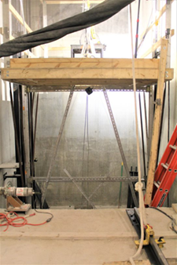
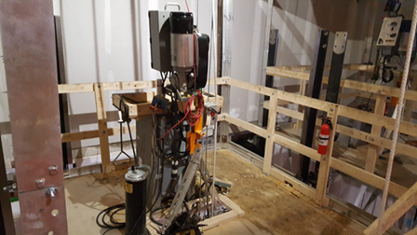
Hoists and Elevators
False Car means a temporary movable hoistway working platform, generally assembled on the jobsite by the Elevator Constructors for the purpose of installing elevator equipment. This conveyance will have manual or overspeed safeties, and its suspension means are temporary.

Slide 6
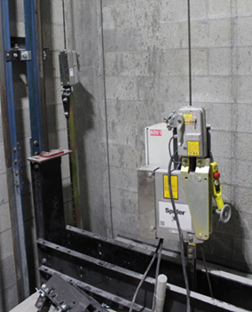
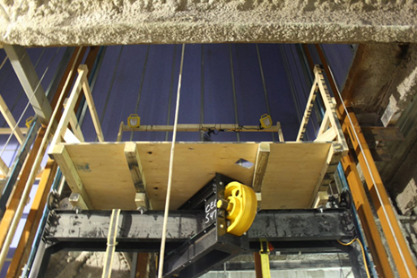
Hoists and Elevators
Running/working platform means a permanent elevator car sling and platform used for the purpose of installing elevator equipment. This conveyance will require the installation of governor actuated safeties or overspeed device and permanent or temporary suspension means. Before hoisting or roping of a platform, the governor or overspeed device must be installed and attached to the safety releasing arm and tested to ensure that the safety is operational. The working platforms below are using a temporary hoist for the suspension means.

Slide 7
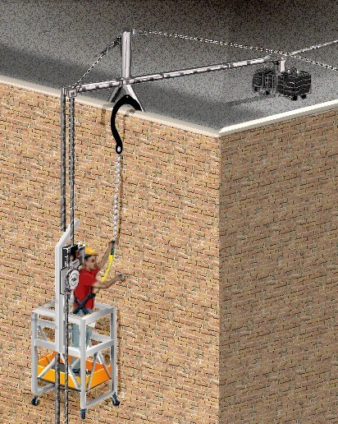
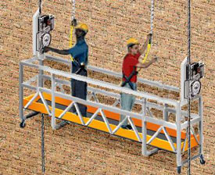
Hoists and Elevators
1926.450(b):
Suspension scaffold means one or more platforms suspended by ropes or other non-rigid means from an overhead structure(s).
Two-point suspension scaffold (swing stage) means a suspension scaffold consisting of a platform supported by hangers (stirrups) suspended by two ropes from overhead supports and equipped with means to permit the raising and lowering of the platform to desired work levels.

Slide 8
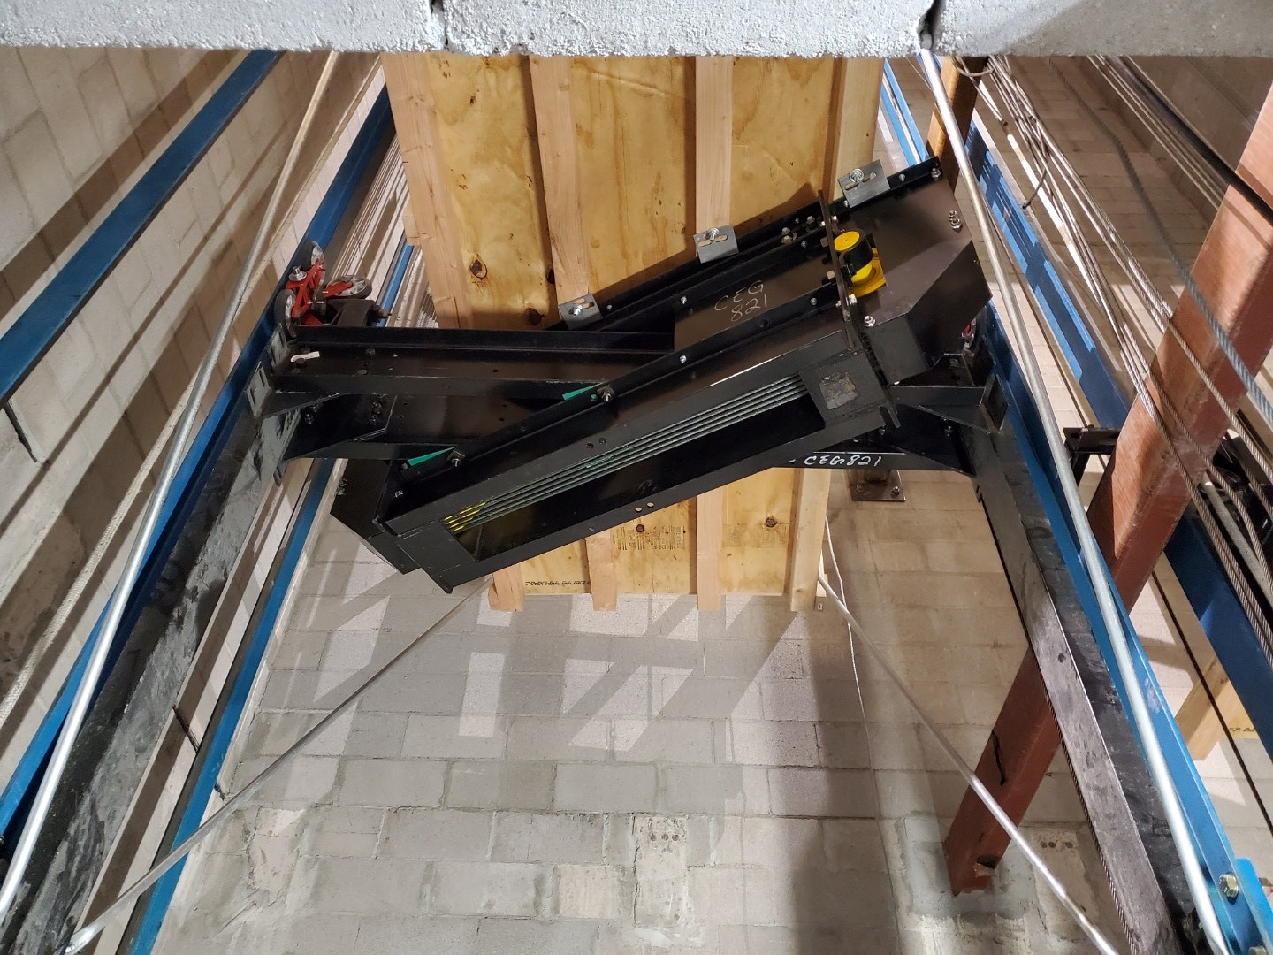
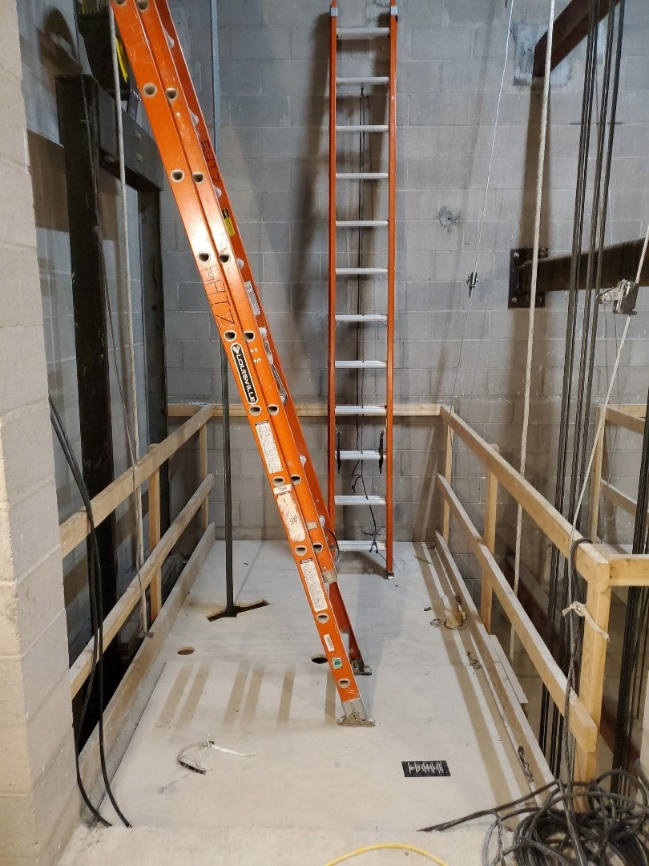
Hoists and Elevators
This working platform is using the permanent hoist machine and roping, and requires the installation of the governor. The governor rope must be attached to the safety releasing arm and tested to ensure that the safety is operational.

Slide 9
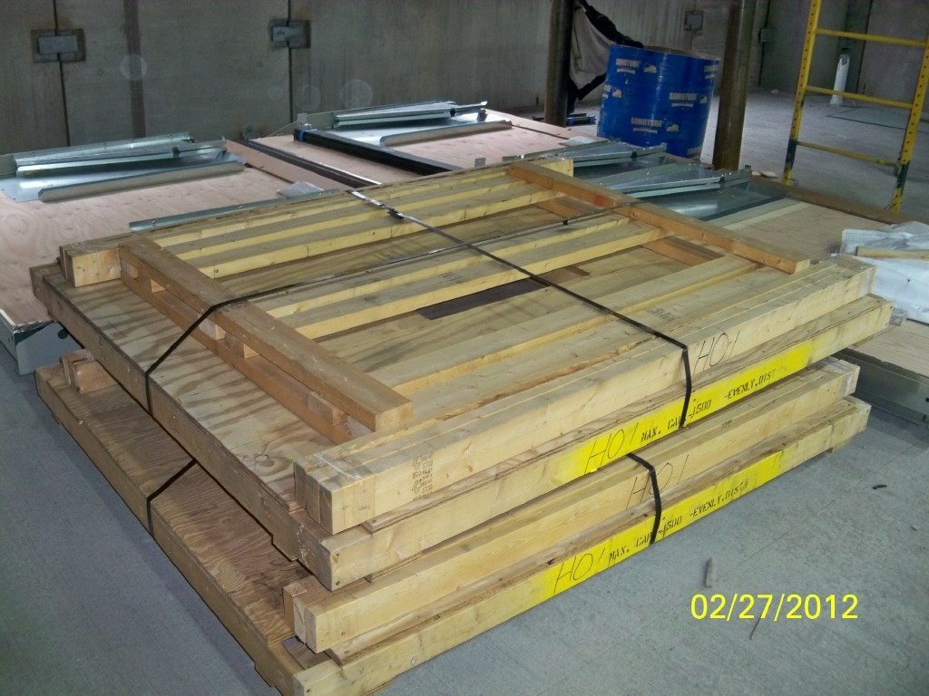
Hoists and Elevators
Platform materials are usually pre-engineered and sent directly from the manufacturer. Always follow manufacturer’s instructions when installing platforms and guardrail systems.

Slide 10
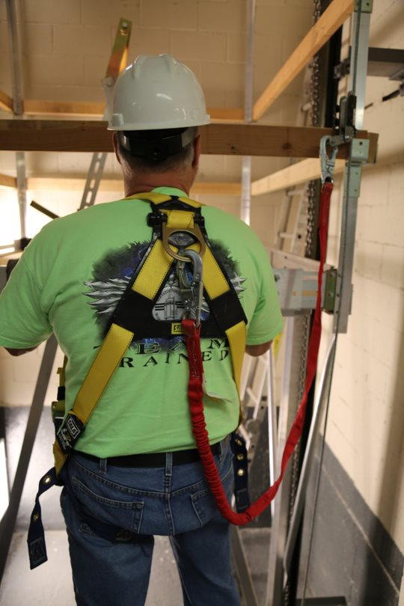
Hoists and Elevators
Fall Protection Required
If a fall hazard exists, the conveyance must meet the fall protection requirements of OSHA 1926.502. Always follow your company safe work practices for fall hazards.
Notes:
If classified as a running/working platform, 1926.501(b)(1)
Unprotected sides and edges. Each employee on a walking/working surface (horizontal and vertical surface) with an unprotected side or edge which is 6 feet (1.8 m) or more above a lower level shall be protected from falling by the use of guardrail systems, safety net systems, or personal fall arrest systems.
Each employee on a scaffold more than 10 feet (3.1 m) above a lower level shall be protected from falling to that lower level.
If classified as a false car/suspension scaffold, 1926.451(g)(1)(ii)
Each employee on a single-point or two-point adjustable suspension scaffold shall be protected by both a personal fall arrest system and guardrail system;

Slide 11
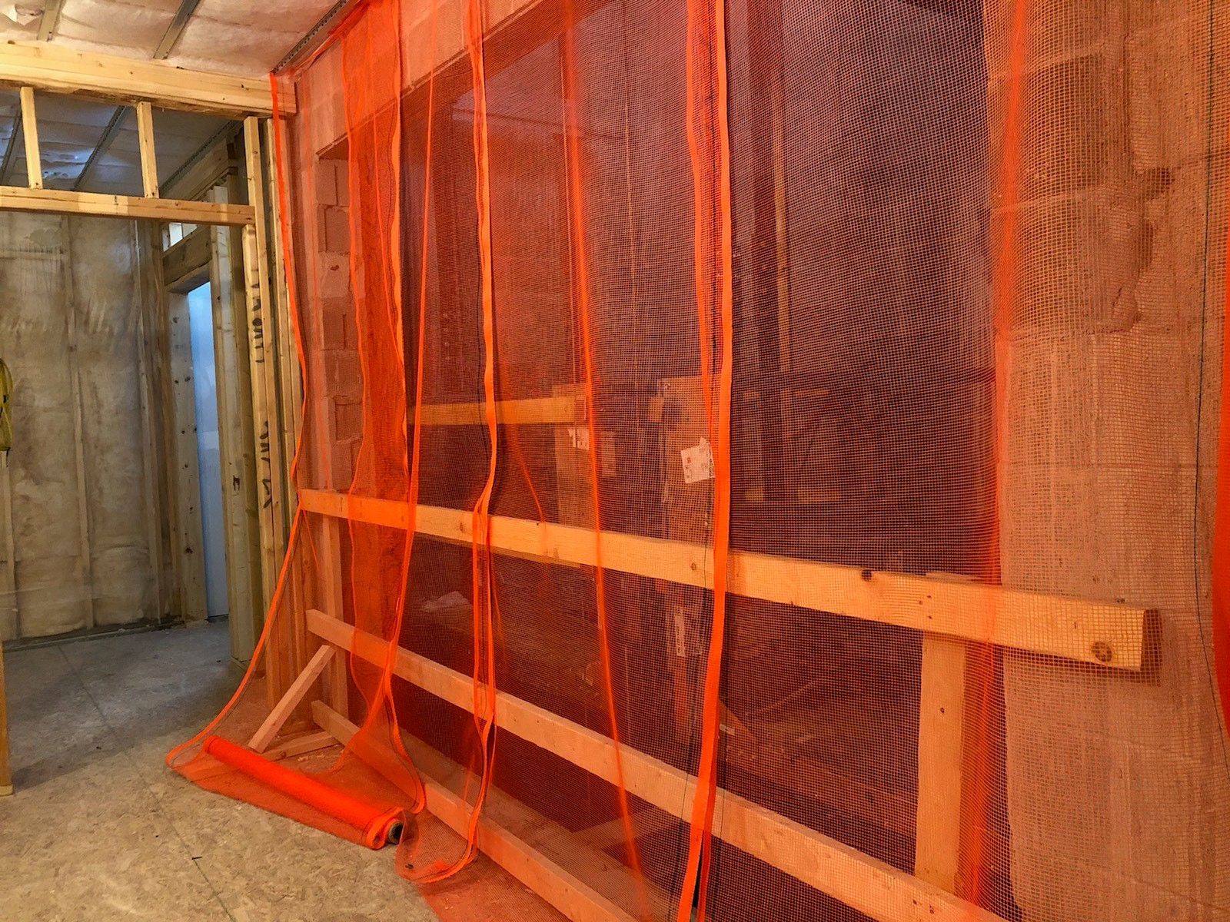
Hoists and Elevators
Overhead Protection
In addition to fall protection, overhead protection must be provided to protect workers from objects falling down the hoistway.
This can be accomplished by fully enclosing the hoistway openings with protective netting, installing a canopy structure on the conveyance, or barricade the area to prohibit people from entering.
Notes:
Protection from falling objects. When an employee is exposed to falling objects, the employer shall have each employee wear a hard hat and shall implement one of the following measures: [1926.501(c)]
(1) Erect toeboards, screens, or guardrail systems to prevent objects from falling from higher levels; or, [1926.501(c)(1)]
(2) Erect a canopy structure and keep potential fall objects far enough from the edge of the higher level so that those objects would not go over the edge if they were accidentally displaced; or, [1926.501(c)(2)]
(3) Barricade the area to which objects could fall, prohibit employees from entering the barricaded area, and keep objects that may fall far enough away from the edge of a higher level so that those objects would not go over the edge if they were accidentally displaced. [1926.501(c)(3)]

Slide 12
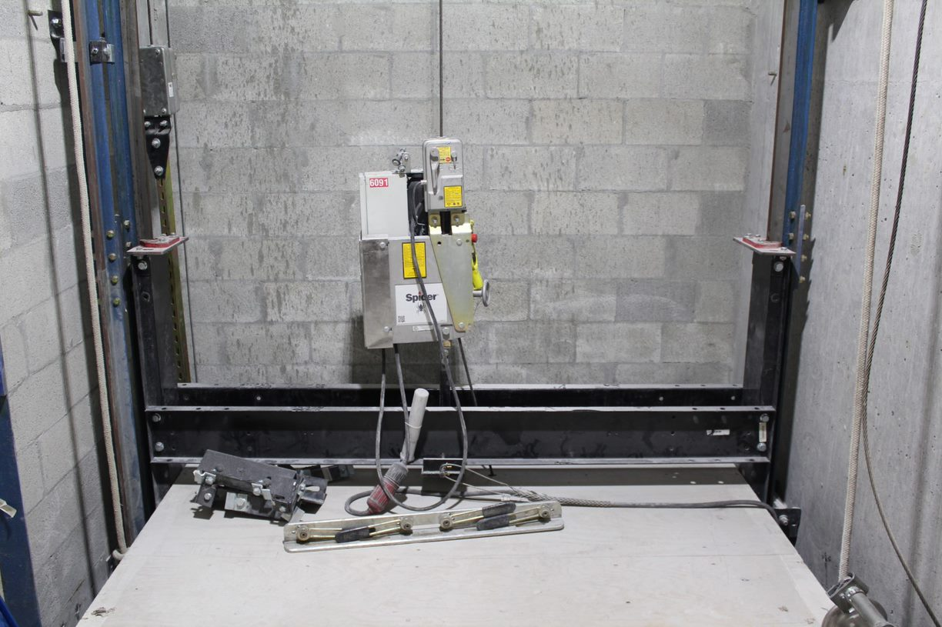
Hoists and Elevators
Testing/Inspection
Temporary hoists must have the safeties tested before each shift, and the hoist cable must be inspected daily.
Always follow the hoist manufacturer’s instructions for testing and inspection.
Notes:
1926.451(d)(10):
Ropes shall be inspected for defects by a competent person prior to each workshift and after every occurrence which could affect a rope's integrity. Ropes shall be replaced if any of the following conditions exist:
(i) Any physical damage which impairs the function and strength of the rope. [1926.451(d)(10)(i)]
(ii) Kinks that might impair the tracking or wrapping of rope around the drum(s) or sheave(s). [1926.451(d)(10)(ii)]
(iii) Six randomly distributed broken wires in one rope lay or three broken wires in one strand in one rope lay. [1926.451(d)(10)(iii)]
(iv) Abrasion, corrosion, scrubbing, flattening or peening causing loss of more than one-third of the original diameter of the outside wires. [1926.451(d)(10)(iv)]
(v) Heat damage caused by a torch or any damage caused by contact with electrical wires. [1926.451(d)(10)(v)]
(vi) Evidence that the secondary brake has been activated during an overspeed condition and has engaged the suspension rope. [1926.451(d)(10)(vi)]

Slide 13
Hoists and Elevators
Power Cables and Run Buttons
Power cables and temporary run button cords should always have a strain relief on the cord.
Temporary run buttons must ALWAYS have a minimum of 5 wires with an independently wired emergency stop switch, and must have safe, up, and down buttons.
Never use a pendant station with only an up and down button.
Temporary run button cords should NEVER be spliced. OSHA Standard 1926.405(g)(2)(iii) states: Flexible cords shall be used only in continuous lengths without splice or tape (see note on OSHA standard for hard service flexible cords no. 12 or larger)
Notes:
Splices. Flexible cords shall be used only in continuous lengths without splice or tap. Hard service flexible cords No. 12 or larger may be repaired if spliced so that the splice retains the insulation, outer sheath properties, and usage characteristics of the cord being spliced. [1926.405(g)(2)(iii)]

Slide 14
Hoists and Elevators
Summary
The hoistway is your space. No other trades should ever work above you.
Always follow your company’s policies and procedures when assembling and operating false cars and running/working platforms.
Inspect and test equipment according to the manufacturer’s instructions.
Identify and follow capacities for false cars and running/working platforms.

Slide 15
Hoists and Elevators
Check Your Knowledge
Overhead protection can be accomplished by installing guardrails at all hoistway openings.
True
False
b. False.
Overhead protection can be accomplished by installing debris netting at all hoistway openings.

Slide 16
Hoists and Elevators
Check Your Knowledge
How often must the safeties be tested on a temporary hoist?
Daily
Weekly
Monthly
Before each shift
d. Before each shift

Slide 17
Hoists and Elevators
Check Your Knowledge
Temporary run buttons must ALWAYS have a minimum of 5 wires with an independently wired emergency stop switch, and must have safe, up, and down buttons.
True
False
d. True

Slide 18
Hoists and Elevators

