Slide 1

1910 General Industry
Personal Protective Equipment

Slide 2

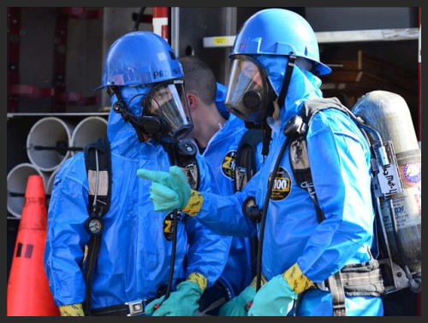
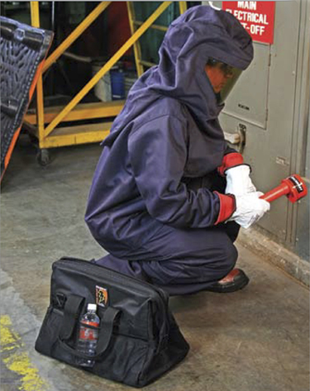
Introduction
Source of photos: OSHA
Notes:
OSHA requires employees to protect their employees from workplace hazards through the use of engineering or work practice controls.
When these controls are not feasible or do not provide sufficient protection, the use of personal protective equipment (PPE) is required.

Slide 3
Introduction
Lesson objectives:
Describe the hierarchy of controls as it relates to personal protective equipment
Identify types of personal protective equipment used in general industry work
Explain personal protective equipment training requirements
Explain the employer’s responsibilities regarding personal protective equipment
Explain the employee’s responsibilities regarding personal protective equipment
Notes:
Objectives:
Describe the hierarchy of controls as it relates to personal protective equipment.
Identify types of personal protective equipment used in general industry work
Explain personal protective equipment training requirements.
Explain the responsibilities of the employer regarding personal protective equipment.
Explain the responsibilities of the employee regarding personal protective equipment.

Slide 4
Introduction
Employers must protect employees:
Assess the workplace
Eliminate and reduce the hazards found using engineering and administrative controls
Then use appropriate personal protective equipment
Remember, Personal Protective Equipment is the last level of control.

Slide 5
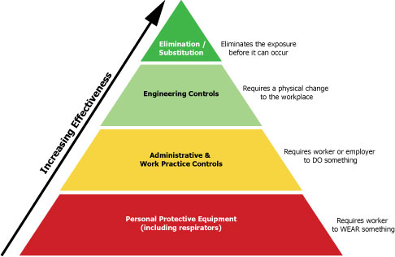
Hierarchy of Controls
Source: OSHA
Notes:
The Hierarchy of Control Methods
Graphic illustrates the effectiveness of the systems used to prevent and control hazards.
Elimination/substitution
Provides the highest level of protection against hazards.
The hazard is eliminated from the workplace or a safer item/substance is substituted for the more hazardous item/substance.
Engineering controls are the second most effective means of protecting employees from hazards, followed by administrative and work practice controls.
PPE - last resort; it is least effective

Slide 6
Hierarchy of Controls
Elimination/substitution:
Highest level of protection
Eliminate hazards from the workplace
Substitute
  Use safer item/substance
  Use same chemical but in a different form; as particle size of a substance decreases, hazard level increases
Source: OTIEC Workgroup
Notes:
Elimination / substitution:
Provides the highest level of protection against hazards.
The hazard is eliminated from the workplace or a safer item/substance is substituted for the more hazardous item/substance.
Another type of substitution includes using the same chemical but to use it in a different form.
For example, a dry, dusty powder may be a significant inhalation hazard but if this material can be purchased and used as pellets or crystals, there may be less dust in the air and therefore less exposure.

Slide 7
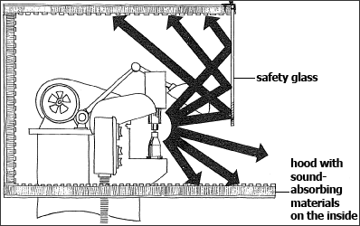
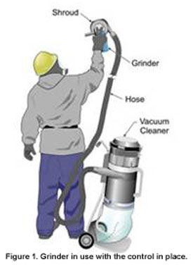
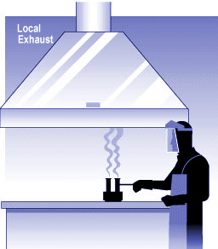
Hierarchy of Controls
Engineering controls:
Physical changes to workplace
Examples
  Isolation
  Ventilation
  Equipment modification
  Others
Notes:
Engineering controls
Requires a physical change to the workplace
Based on the following principles: (OSHA 2001)
If feasible, design the facility, equipment, or process to remove the hazard.
If removal is not feasible, enclose the hazard to prevent exposure in normal operations.
Where complete enclosure is not feasible, establish barriers or local ventilation to reduce exposure to the hazard in normal operations.
Examples
Isolation – hazard is enclosed prohibiting exposure to worker
Ventilation – air exchanges to reduce atmospheric hazards
Equipment modifications – reduce the hazard through design of the equipment or attachments (Examples: reduced vibration, dust collection system, noise reduction, etc.)

Slide 8
Hierarchy of Controls
Administrative controls/work practice control:
Requires worker or employer to do something
Examples
  Written proper operating procedures, work permits, and safe work practices
  Inspection and maintenance
  Housekeeping
  Monitoring the use of highly hazardous materials
  Supervision
  Training
  Alarms, signs, and warnings
  Regulated areas
  Limited exposure by time or distance
Notes:
Administrative Controls
Includes work practices
Requires the worker or employer to do something
Examples
Proper procedures – workplace rules and other operation-specific rules
Inspection and maintenance – regularly inspect tools and equipment; keep them well maintained; remove from service any damaged or broken items
Housekeeping
Supervision
Regulated areas – designate areas for lunch and break times; no eating, drinking, smoking, chewing tobacco or gum, or applying cosmetics in workplace
Limited exposure by time and distance – shorten amount of time a worker is exposed to task involving the hazard; distance hazard from workers

Slide 9
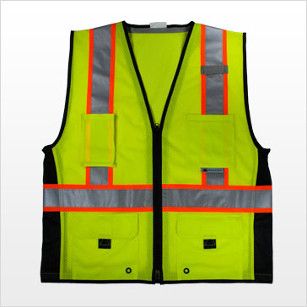
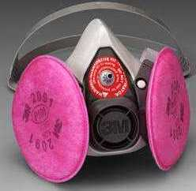
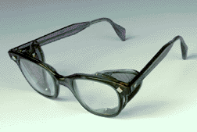
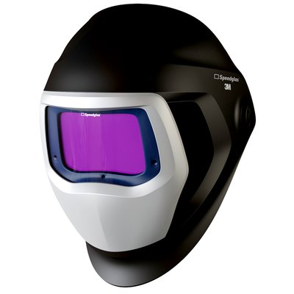
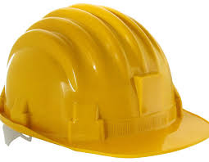
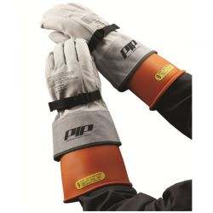

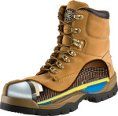
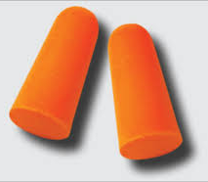
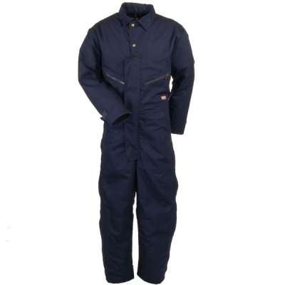
Hierarchy of Controls
PPE controls:
Requires worker to wear something
Examples
Source of Photos: OSHA
Notes:
OSHA requires employees to protect their employees from workplace hazards through the use of engineering or work practice controls.
When these controls are not feasible or do not provide sufficient protection, the use of personal protective equipment (PPE) is required.

Slide 10

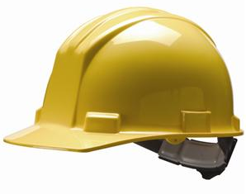
Types of PPE
Head protection:
Frequent causes of head injuries include:
  Falling objects from above striking on the head
  Bump head against fixed objects, such as exposed pipes or beams
  Accidental head contact with electrical hazards
Source: OSHA
Notes:
“Wearing a safety helmet or hard hat is one of the easiest ways to protect an employee's head from injury. Hard hats can protect employees from impact and penetration hazards as well as from electrical shock and burn hazards.
Employers must ensure that their employees wear head protection if any of the following apply:
Objects might fall from above and strike them on the head;
They might bump their heads against fixed objects, such as exposed pipes or beams; or
There is a possibility of accidental head contact with electrical hazards.”
(OSHA Publication 3151-12R, 2003)

Slide 11
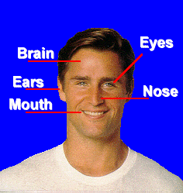
Types of PPE
Why head protection is important…
Source: OSHA
Notes:
“Protecting employees from potential head injuries is a key element of any safety program. A head injury can impair an employee for life or it can be fatal.”
(OSHA Publication 3151-12R, 2003)
Your head is a very delicate part of your body. In and around your head are:
Your eyes, with which you see;
Your ears, with which you hear;
Your nose, with which you smell;
Your mouth, with which you eat and speak; and
Your brain, with which you think.
Injuries to the head are very serious. For this reason, head protection and safety are very important.

Slide 12

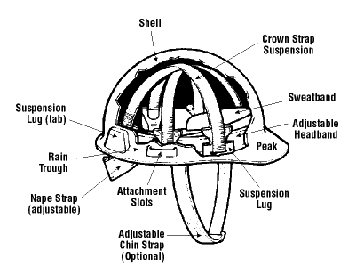
Types of PPE
Classes of hard hats:
  CLASS G (General)
    Protects against impact and penetration
    Low-voltage electrical protection (proof-tested to 2,200 volts)
Source of graphics: OSHA
Notes:
https://www.osha.gov/Publications/osha3151.html
“There are many types of hard hats available in the marketplace today. In addition to selecting protective headgear that meets ANSI standard requirements, employers should ensure that employees wear hard hats that provide appropriate protection against potential workplace hazards. It is important for employers to understand all potential hazards when making this selection, including electrical hazards. This can be done through a comprehensive hazard analysis and an awareness of the different types of protective headgear available.”
(OSHA Publication 3151-12R, 2003)
Class G hard hats are intended for general service use, such as building construction, shipbuilding, lumbering, and manufacturing. Class G hard hats provide good impact protection, but limited voltage protection (proof-tested at 2,200 volts).

Slide 13
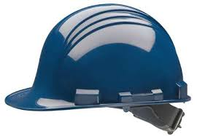
Types of PPE
  CLASS E (Electrical)
    Designed for electrical/utility work
    Protects against falling objects & impact
    Electrical protection against high-voltage
    (proof-tested to 20,000 volts)
Source: OSHA
Notes:
Class E hard hats are designed for electrical/utility work. They protect against falling objects and provide protection against conductors with higher voltage levels (proof-tested at 20,000 volts).

Slide 14

Types of PPE
  CLASS C (Conductive)
    Designed for comfort; offers limited protection
    Protects heads that may bump against fixed objects
    Does not protect against falling objects or electrical hazards
Source: OSHA
Notes:
For impact and penetration only. Usually made of aluminum, so it should not be used near areas with electrical hazards.
Class C hard hats provide limited protection, mostly from bumps against fixed objects. Class C hard hats do not provide any protection against electrical hazards.

Slide 15
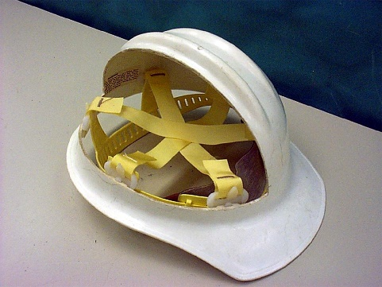
Types of PPE
ANSI Z89.1, 1997
  Type I: provides protection from objects that fall directly on top of the helmet, but not from objects that strike the side, front, or back of the head.
  Type II: provides protection from strikes to the top of the head, and also provides protection from blows to the sides, front, and back of the head. More suitable for workers who are not always in a standing position.
Source of photos: OSHA

Slide 16
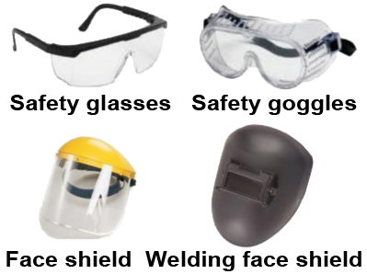
Types of PPE
Eye and face protection:
Source of images: OSHA

Slide 17

Types of PPE
Common causes of eye injuries
  Chemical splashes
  Blood or OPIM splashes or sprays
  Intense light
  Dust and other flying particles
  Molten metal splashes
Source: OSHA
Notes:
https://www.osha.gov/Publications/osha3151.html
“Employees can be exposed to a large number of hazards that pose danger to their eyes and face. OSHA requires employers to ensure that employees have appropriate eye or face protection if they are exposed to eye or face hazards from flying particles, molten metal, liquid chemicals, acids or caustic liquids, chemical gases or vapors, potentially infected material or potentially harmful light radiation.”
(OSHA Publication 3151-12R, 2003)
Examples:
Acids and other caustic liquid chemicals that might splash
Blood and other potentially infectious materials that might splash, spray
Intense light such as that created by welding and lasers
Dust and other flying particles, such as sawdust or metal shavings
Molten metal that might splash
1910.133 (b) Criteria for protective eye and face protection
Eye and face protection equipment required by this Part shall meet the requirements specified in American National Standards Institute, and devices must comply with any of the following : Z87.1-2003, ANSI Z87.1-1998 (R-1998), ANSI Z87.1-1989
Practice for Occupational and Educational Eye and Face Protection. Incorporated by reference in 1910.6

Slide 18
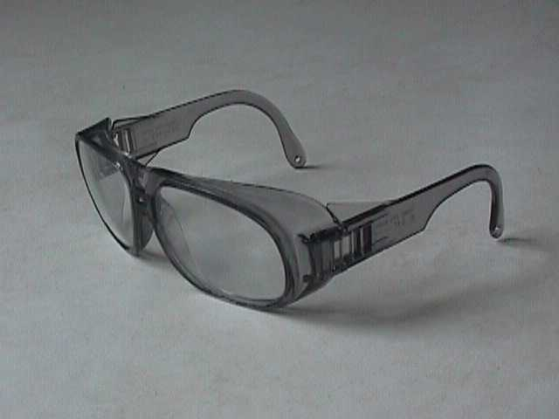
Types of PPE
Eye and face protection – must comply with
  ANSI Z87.1-2003, or
  ANSI Z87.1-1989 (R-1998)
Source: OSHA
Notes:
www.osha.gov/SLTC/etools/eyeandface/employer/requirements.html
Eye and face protection must comply with the American National Standards Institute, ANSI Z87.1-2003
Eye and face personal protective equipment (PPE) shall be distinctly marked to facilitate identification of the manufacturer. [29 CFR 1910.133(a)(4)]
The following minimum requirements must be met by all protective devices. Protectors shall:
Provide adequate protection against the particular hazards for which they are designed.
Be of safe design and construction for the work to be performed.
Be reasonably comfortable when worn under the designated conditions.
Fit snugly and not unduly interfere with the movements of the wearer.
Be durable.
Be capable of being disinfected.
Be easily cleanable.
Be distinctly marked to facilitate identification only of the manufacturer.
www.osha.gov/SLTC/etools/eyeandface/index.html

Slide 19
Types of PPE
Selecting eye and face protection – elements to consider:
  Ability to protect against workplace hazards
  Should fit properly
  Should provide unrestricted vision and movement
  Durable and cleanable
  Allows unrestricted functioning of other PPE
Notes:
1910.133
Eye and face protection equipment required by this Part shall meet the requirements specified in American National Standards Institute, Z87.1-2003, Z87.1-1989 (Rr-1998) incorporated by reference in 19110.06, Practice for Occupational and Educational Eye and Face Protection.
https://www.osha.gov/Publications/osha3151.html
“Selecting the most suitable eye and face protection for employees should take into consideration the following elements:
Ability to protect against specific workplace hazards.
Should fit properly and be reasonably comfortable to wear.
Should provide unrestricted vision and movement.
Should be durable and cleanable.
Should allow unrestricted functioning of any other required PPE.”
(OSHA Publication 3151-12R, 2003)

Slide 20
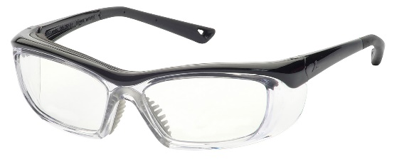
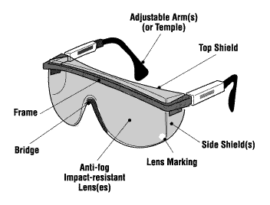
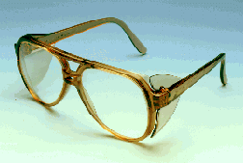
Types of PPE
Safety glasses
  Used to protect against moderate impacts from particles
Source of graphics: OSHA

Slide 21

Types of PPE
Prescription glasses
  Employees who use
  prescription glasses while
  performing operations with
  potential eye hazards must use
  eye protection that:
    Incorporates the prescription in its design, or
    Can be used over your prescription glasses without interfering with the proper positioning of the prescription glasses or goggles
Source: OSHA
Notes:
https://www.osha.gov/SLTC/etools/eyeandface/employer/requirements.html
“Employers must ensure that employees who wear prescription (Rx) lenses or contacts use personal protective equipment (PPE) that incorporates the prescription or use eye protection that can be worn over prescription lenses without interfering with the proper positioning of the prescription glasses or goggles.”

Slide 22
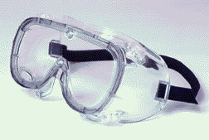
Types of PPE
Goggles
  Protect eyes, and the
  facial area immediately surrounding the eyes from
  impact, dust, splashes.
  Some can be used over corrective lenses, if they fit them.
Source: OSHA

Slide 23
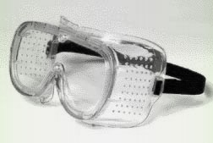
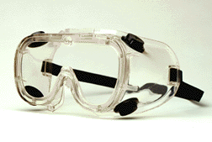
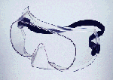
Types of PPE
  Goggle types
Direct-ventilated
Indirect-ventilated
Non-ventilated
Resist direct passage of large particles into the goggle
Prevents fogging by allowing air circulation
Prevents fogging by allowing air circulation
Protects against liquid or chemical splash entry
Does not allow the passage of air into the goggle
Prevents splash entry
May fog and require frequent lens cleaning
Source: OSHA.gov
Notes:
Safety goggles are used as primary protection to shield the eyes from heat hazards. Goggles form a protective seal around the eyes, preventing objects or liquids from entering under or around the goggles. This is especially important when working with or around molten metals that may splash.
When employees are exposed to high temperatures, additional protection beyond that offered by primary protectors may be required. Use safety goggles in combination with a heat-reflective face shield for severe temperatures exposure. Consider specific lens, frame, and ventilation options when selecting safety goggles.
Ventilated goggles allow air circulation while providing protection against airborne particles, dust, liquids, or light.

Slide 24
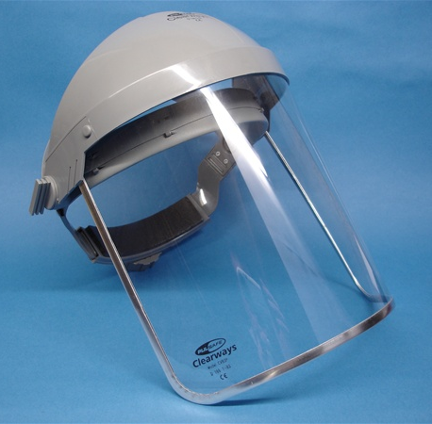
Types of PPE
Face shields
  Protect face from nuisance
  dusts and potential splashes
  or sprays of hazardous liquids
  Shields do not protect from
  impact hazards unless so rated
  Shields are for face protection, not eye protection. To protect the eyes, wear safety glasses with side shields, or goggles under the face shield.
Source: OSHA
Notes:
https://www.osha.gov/SLTC/etools/eyeandface/ppe/impact.html#faceshields
“Face shields are intended to protect the entire face or portions of it from impact hazards such as flying fragments, objects, large chips, and particles. When worn alone, face shields do not protect employees from impact hazards. Use face shields in combination with safety spectacles or goggles, even in the absence of dust or potential splashes, for additional protection beyond that offered by spectacles or goggles alone.”
(OSHA Eye and Face Protection eTool, 2002)

Slide 25
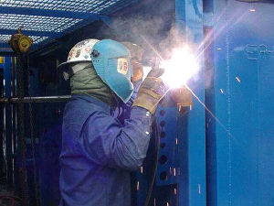
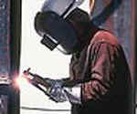
Types of PPE
Welding shields
  Protect eyes from burns caused by:
    Infrared light
    Intense radiant light
  Protect eyes and face from flying sparks, metal spatter, and slag chips
Source of photos: OSHA
Notes:
https://www.osha.gov/Publications/osha3151.html
“Constructed of vulcanized fiber or fiberglass and fitted with a filtered lens, welding shields protect eyes from burns caused by infrared or intense radiant light; they also protect both the eyes and face from flying sparks, metal spatter, and slag chips produced during welding, brazing, soldering and cutting operations. OSHA requires filter lenses to have a shade number appropriate to protect against the specific hazards of the work being performed in order to protect against harmful light radiation.”
(OSHA Publication 3151-12R, 2003)

Slide 26
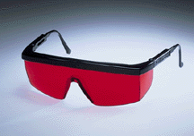
Types of PPE
Laser safety goggles
  Provide protection from hazards:
    Physical contact such as flying particles
    Ultraviolet light, laser, and welding
Source: OSHA

Slide 27
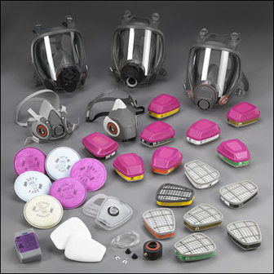
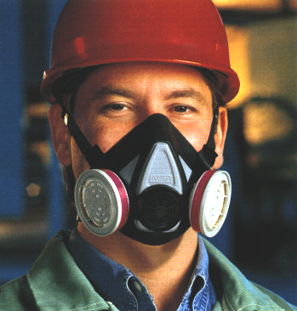
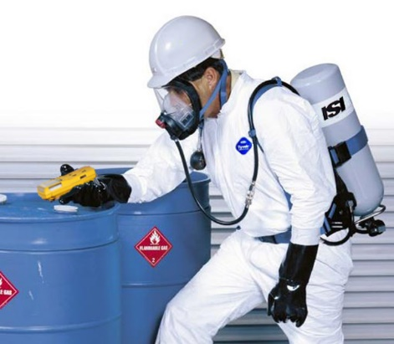
Types of PPE
Respiratory protection:
Source of photos: OSHA

Slide 28
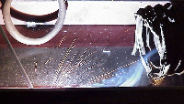
Types of PPE
Elimination/substitution or engineering controls
  Eliminate toxic material or substitute a less toxic material
  Enclose or confine operation
  General or local exhaust
  ventilation
Only when engineering
controls are not feasible
will respirators be used
Source: OSHA

Slide 29
Types of PPE
Types of respirators
  Air-purifying (APR) – remove contaminants from air
    Particulate respirators
    Chemical cartridge/
    gas mask respirator
    Powered air-purifying respirator (PAPR)
Source of photos: OSHA
Notes:
Source: https://www.osha.gov/Publications/osha3079.pdf
“There are two major classes of respirators:
Air-purifying, which remove contaminants from the air; and
Atmosphere-supplying, which provide clean, breathable air from an uncontaminated source. As a general rule, atmosphere-supplying respirators are used for more hazardous exposures.”
Source: https://www.osha.gov/dts/shib/respiratory_protection_bulletin_2011.html
“Respirators work by either filtering particles from the air, chemically cleaning (purifying) the air, or supplying clean air from an outside source.
Particulate Respirators: Particulate respirators are the simplest, least expensive, and least protective of the respirator types available. These respirators only protect against particles (e.g., dust). They do not protect against chemicals, gases, or vapors, and are intended only for low hazard levels. The commonly known "N-95" filtering facepiece respirator or "dust mask" is one type of particulate respirator, often used in hospitals to protect against infectious agents. Particulate respirators are "air-purifying respirators" because they clean particles out of the air as you breathe.
Particulate respirators:
Filter out dusts, fumes and mists.
Are usually disposable dust masks or respirators with disposable filters.
Must be replaced when they become discolored, damaged, or clogged.
Examples: filtering facepiece or elastomeric respirator.
Chemical Cartridge/Gas Mask Respirator: Gas masks are also known as "air-purifying respirators" because they filter or clean chemical gases out of the air as you breathe. This respirator includes a facepiece or mask, and a cartridge or canister. Straps secure the facepiece to the head. The cartridge may also have a filter to remove particles.
Gas masks are effective only if used with the correct cartridge or filter (these terms are often used interchangeably) for a particular biological or chemical substance. Selecting the proper filter can be a complicated process. There are cartridges available that protect against more than one hazard, but there is no "all-in-one" cartridge that protects against all substances. It is important to know what hazards you will face in order to be certain you are choosing the right filters/cartridges.
Chemical Cartridge/Gas Mask respirator:
Uses replaceable chemical cartridges or canisters to remove the contaminant.
Are color-coded to help you select the right one.
May require more than one cartridge to protect against multiple hazards.
Powered Air-Purifying Respirator (PAPR): Powered air-purifying respirators use a fan to draw air through the filter to the user. They are easier to breathe through; however, they need a fully charged battery to work properly. They use the same type of filters/cartridges as other air-purifying respirators. It is important to know what the hazard is, and how much of it is in the air, in order to select the proper filters/cartridges.”

Slide 30
Types of PPE
  Atmosphere-supplying – provide clean, breathable air
    Self-contained breathing apparatus (SCBA)
    Supplied-air respirator (SAR)
Source of photos: OSHA
Notes:
Source: https://www.osha.gov/Publications/osha3079.pdf
“There are two major classes of respirators:
Air-purifying, which remove contaminants from the air; and
Atmosphere-supplying, which provide clean, breathable air from an uncontaminated source. As a general rule, atmosphere-supplying respirators are used for more hazardous exposures.”
Source: https://www.osha.gov/dts/shib/respiratory_protection_bulletin_2011.html
“Self-Contained Breathing Apparatus (SCBA) is the respirator commonly used by firefighters. These use their own air tank to supply clean air, so you don't need to worry about filters. They also protect against higher concentrations of dangerous chemicals. However, they are very heavy (30 pounds or more), and require very special training on how to use and to maintain them. Also, the air tanks typically last an hour or less depending upon their rating and your breathing rate (how hard you are breathing).
Self-Contained Breathing Apparatus:
Provide clean air from a portable air tank when the air around you is simply too dangerous to breathe.
All of these respirators (except for the "dust masks" or filtering face pieces) are available in either half-mask or full-face pieces.”
Source: https://www.osha.gov/dte/library/respirators/presentation/index.html
Supplied Air Respirator (SAR)
“An atmosphere-supplying respirator for which the source of breathing air is not designed to be carried by the user. Also called airline respirator.”

Slide 31
Types of PPE
Medical evaluation
  Before fit tests are conducted and employee is authorized the use of a respirator, a medical evaluation must be provided to determine the ability of the employee to use a respirator.
  Identify a physician or other license health care professional (PLHCP) to perform medical evaluations using a medical questionnaire or an initial medical evaluation with which the same information is obtained.

Slide 32
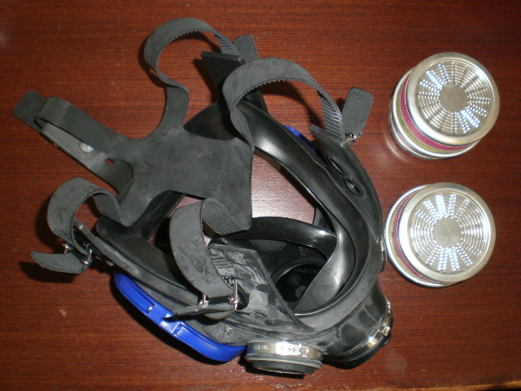
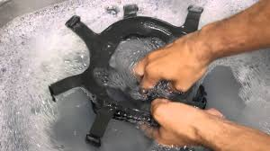
Types of PPE
Inspecting and cleaning respirators
  Inspect all respirators for wear and tear before and after each use
  Wash in a detergent solution, then disinfect by immersing in a sanitizing solution
Source of photos: Carmen Vazquez
Notes:
Source: Respiratory Protection (2002), OSHA #3079, https://www.osha.gov/Publications/OSHA3079/osha3079.html
“It is important to inspect all respirators for wear and tear before and after each use, giving special attention to rubber or plastic parts that can deteriorate or lose pliability. The facepiece, headband, valves, connecting tube, fittings, and cartridges, canisters or filters must be in good condition. A respirator inspection must include checking the tightness of the connections.
Users must inspect SCBAs at least monthly and ensure that air and oxygen cylinders are fully charged according to the manufacturer's instructions. The inspection should include a check of regulator and warning devices to ensure their proper function. Employers must keep records of inspection dates and findings.
Users should replace chemical cartridges and gas mask canisters as necessary to provide complete protection, following the manufacturer's recommendations. In addition, they should replace mechanical filters as necessary to avoid high resistance to breathing.
Only an experienced person is permitted to make repairs, using parts specifically designed for the respirator. This person must consult the manufacturer's instructions for any repair and no attempt should be made to repair or replace components or make adjustments or repairs beyond the manufacturer's recommendations.
The employer must ensure that respirators are cleaned and disinfected as often as necessary to keep them sanitary. In addition, the employer must ensure that emergency-use respirators are cleaned and disinfected immediately after each use.
Respirators should be washed in a detergent solution and then disinfected by immersing them in a sanitizing solution. Cleaner-sanitizers that effectively clean the respirator and contain a bactericidal agent are available commercially. The bactericidal agent frequently used is a quaternary ammonium compound. Strong cleaning and sanitizing agents and many solvents can damage rubber or plastic respirator parts. Use these materials with caution or after consultation with the respirator manufacturer.”

Slide 33
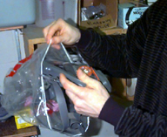
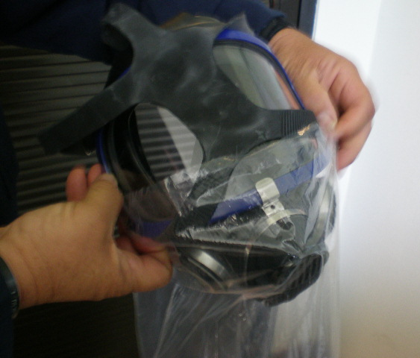
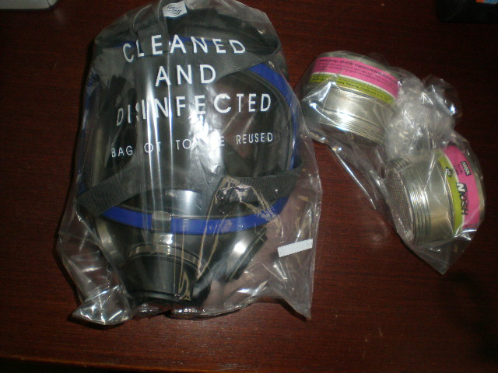
Types of PPE
Storing respirators
  Protect against dust, sunlight, heat, extreme cold, excessive moisture, and damaging chemicals
  Store in position to retain natural configuration
Source of photos: Carmen Vazquez
Notes:
Source: Respiratory Protection (2002), OSHA #3079, https://www.osha.gov/Publications/OSHA3079/osha3079.html
“Users must store respirators in a way that protects them against dust, sunlight, heat, extreme cold, excessive moisture, and damaging chemicals. When packed or stored, each respirator should be positioned to retain its natural configuration. Facepieces and exhalation valves should rest in a normal position to prevent the rubber or plastic from deforming.”

Slide 34
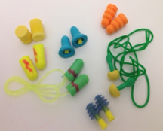
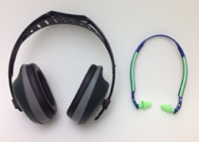
Types of PPE
Hearing protection:
Source of photos: OSHA

Slide 35
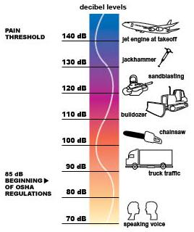
Types of PPE
Exposure to noise levels over 85 dB can cause hearing loss
Hearing protection required at 90 dB
Implement effective hearing conservation program
Source: OSHA
Notes:
https://www.osha.gov/dts/osta/otm/noise/index.html
“Noise, or unwanted sound, is one of the most common health problems in American workplaces. The National Institute for Occupational Safety and Health (NIOSH) estimates that 30 million workers in the U.S. are exposed to hazardous noise. Exposure to high levels of noise may cause hearing loss, create physical and psychological stress, reduce productivity, interfere with communication, and contribute to accidents and injuries by making it difficult to hear warning signals.
OSHA requires employers to determine if workers are exposed to excessive noise in the workplace. If so, the employers must implement feasible engineering or administrative controls to eliminate or reduce hazardous levels of noise. Where controls are not sufficient, employers must implement an effective hearing conservation program.”
(OSHA Noise and Hearing Conservation eTool, 2005)

Slide 36

Types of PPE
The employer must provide ear protection when the noise level in the work area is greater than indicated in this table.
Permissible Noise Exposure 29 CFR 1910.95(b)(1)
Duration per Day (hours) | Sound Level (dBA)
8 | 90
6 | 92
4 | 95
3 | 97
2 | 100
1 | 105
1/2 | 110
1/4 | 115
Source: NIOSH
Impact noise should not exceed 140 dB
Notes:
29 CFR 1910.95(b)(2)
“If the variations in noise level involve maxima at intervals of 1 second or less, it is to be considered continuous.
Footnote(1) When the daily noise exposure is composed of two or more periods of noise exposure of different levels, their combined effect should be considered, rather than the individual effect of each. If the sum of the following fractions: C(1)/T(1) + C(2)/T(2) C(n)/T(n) exceeds unity, then, the mixed exposure should be considered to exceed the limit value. Cn indicates the total time of exposure at a specified noise level, and Tn indicates the total time of exposure permitted at that level. Exposure to impulsive or impact noise should not exceed 140 dB peak sound pressure level.”

Slide 37
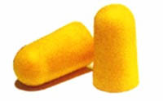
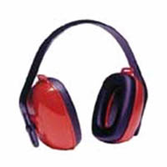
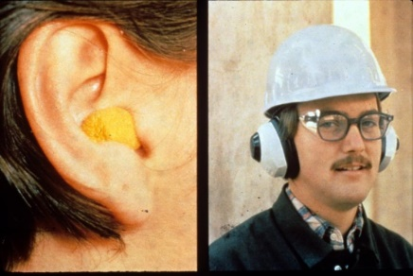
Types of PPE
Examples of hearing protection:
  Disposable foam plugs
  Molded ear plugs
  Noise-cancelling ear plugs
  Earmuffs
Consider the noise reduction
rating (NRR) of devices
Source of photos: OSHA
NIOSH/John Rekus/elcosh.org
Notes:
https://www.osha.gov/dts/osta/otm/noise/index.html
“Hearing protection devices (HPDs) are considered the last option to control exposures to noise. HPDs are generally used during the necessary time it takes to implement engineering or administrative controls, or when such controls are not feasible.”
(OSHA Noise and Hearing Conservation eTool, 2005)
This slide shows some examples of hearing protection devices.
https://www.osha.gov/dts/osta/otm/new_noise/appendixe.pdf
The Noise Reduction Rating of hearing protectors is required labeling on the hearing protector package; manufacturers must identify the noise reduction capability of the product through “laboratory-derived numerical estimate of the attenuation achieved by the protector” (OSHA n.d.).

Slide 38
Types of PPE
How to insert ear plugs properly
Source: NIOSH
Notes:
http://www-esh.fnal.gov/CourseHandout_Mat/earplug.pdf

Slide 39
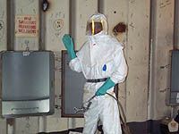
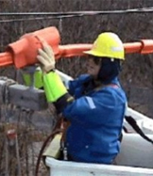

Hand protection:
Types of PPE
Potential hazards for hands
  Skin absorption of hazardous substances
  Lacerations or severe cuts
  Punctures
  Chemical burns
  Thermal burns
  Extreme temperatures
Source of photos: OSHA
Notes:
The employer select and require employees the proper use of hand protection when exposed to hazards.

Slide 40






Types of PPE
Types of gloves
Anti-vibration
Chemical-resistant
Leather Palm
Heat-resistant
Cut-resistant
Permeation-resistant
Source of photos: OSHA
Notes:
https://www.osha.gov/Publications/osha3151.html
“There are many types of gloves available today to protect against a wide variety of hazards. The nature of the hazard and the operation involved will affect the selection of gloves. The variety of potential occupational hand injuries makes selecting the right pair of gloves challenging. It is essential that employees use gloves specifically designed for the hazards and tasks found in their workplace because gloves designed for one function may not protect against a different function even though they may appear to be an appropriate protective device.
The following are examples of some factors that may influence the selection of protective gloves for a workplace.
Type of chemicals handled.
Nature of contact (total immersion, splash, etc.).
Duration of contact.
Area requiring protection (hand only, forearm, arm).
Grip requirements (dry, wet, oily).
Thermal protection.
Size and comfort.
Abrasion/resistance requirements.
Gloves made from a wide variety of materials are designed for many types of workplace hazards. In general, gloves fall into four groups:
Gloves made of leather, canvas or metal mesh;
Fabric and coated fabric gloves;
Chemical- and liquid-resistant gloves;
Insulating rubber gloves”
(OSHA Publication 3151-12R, 2003)

Slide 41

Types of PPE
Foot and leg protection:
Causes of foot injuries:
  Falling or rolling of heavy objects
  Crushing or penetrating materials
  Sharp objects that can penetrate
  the sole
  Exposure to molten metal
  Working on or around hot, wet, or slippery surfaces
  Working when electrical
  hazards are present
  Source: OSHA
Notes:
Employees who face possible foot or leg injuries from falling or rolling objects or from crushing or penetrating materials should wear protective footwear. Also, employees whose work involves exposure to hot substances or corrosive or poisonous materials must have protective gear to cover exposed body parts, including legs and feet….
Examples of situations in which an employee should wear foot and/or leg protection include:
When heavy objects such as barrels or tools might roll onto or fall on the employee's feet;
Working with sharp objects such as nails or spikes that could pierce the soles or uppers of ordinary shoes;
Exposure to molten metal that might splash on feet or legs;
Working on or around hot, wet, or slippery surfaces; and
Working when electrical hazards are present.”
(OSHA Publication 3151-12R, 2003)

Slide 42

Types of PPE
Conditions requiring foot protection
  Impacts
  Compressions
  Cuts/punctures
  Chemicals
  Temperatures
  Source: OSHA
Notes:
IMPACTS – loading or handling materials such as packages, equipment or heavy objects that could fall
COMPRESSIONS – activities involving vehicles (manual material handling carts)
CUTS/PUNCTURES – sharp objects such as nails, wire, tacks, staples, screws, scrap metal
CHEMICALS – verify with your supervisor and/or the SDS (Safety Data Sheet) for adequate protection
TEMPERATURES – extreme hot or cold work surfaces and/or materials

Slide 43


Types of PPE
Examples of foot and leg protection
  Impact-resistant toe and/or instep
    Steel
    Composite
  Heat-resistant soles
  Metal shanks
  Specialty footwear may be needed
    Metatarsal guards
    Liquid- or chemical-resistant
    Conductive or nonconductive
Source of photos: OSHA
Notes:
https://www.osha.gov/Publications/osha3151.html
“Safety shoes have impact-resistant toes and heat-resistant soles that protect the feet against hot work surfaces common in roofing, paving and hot metal industries. The metal insoles of some safety shoes protect against puncture wounds. Safety shoes may also be designed to be electrically conductive to prevent the buildup of static electricity in areas with the potential for explosive atmospheres or nonconductive to protect workers from workplace electrical hazards.”
“Metatarsal guards protect the instep area from impact and compression. Made of aluminum, steel, fiber or plastic, these guards may be strapped to the outside of shoes.”
“Electrically conductive shoes provide protection against the buildup of static electricity…. Employees exposed to electrical hazards must never wear conductive shoes.”
“Electrical hazard, safety-toe shoes are nonconductive and will prevent the wearers' feet from completing an electrical circuit to the ground. These shoes can protect against open circuits of up to 600 volts in dry conditions and should be used in conjunction with other insulating equipment and additional precautions to reduce the risk of a worker becoming a path for hazardous electrical energy. The insulating protection of electrical hazard, safety-toe shoes may be compromised if the shoes become wet, the soles are worn through, metal particles become embedded in the sole or heel, or workers touch conductive, grounded items. Note: Nonconductive footwear must not be used in explosive or hazardous locations.”
(OSHA Publication 3151-12R, 2003)

Slide 44

Types of PPE
Protective footwear must comply with any of the following consensus standards:
  ANSI Z41.1 – 1991 - "American
  National Standard for Personal
  Protection -- Protective Footwear,"
  ASTM F-2412 – 2005 – “Standard
  Test Methods for Foot Protection”
  ASTM F-2413 – 2005 –
  “Standard Specification for Performance Requirements for Protective Footwear”
  Source: OSHA
Notes:
Criteria for protective footwear.1910.136(b)(1)
Protective footwear must comply with any of the following consensus standards:1910.136(b)(1)(i)
ASTM F-2412-2005, "Standard Test Methods for Foot Protection," and ASTM F-2413-2005, "Standard Specification for Performance Requirements for Protective Footwear," which are incorporated by reference in § 1910.6;1910.136(b)(1)(ii)
ANSI Z41-1999, "American National Standard for Personal Protection -- Protective Footwear," which is incorporated by reference in § 1910.6; or1910.136(b)(1)(iii)
ANSI Z41-1991, "American National Standard for Personal Protection -- Protective Footwear," which is incorporated by reference in § 1910.6.1910.136(b)(2)
Protective footwear that the employer demonstrates is at least as effective as protective footwear that is constructed in accordance with one of the above consensus standards will be deemed to be in compliance with the requirements of this section. [59 FR 16360, April 6, 1994; 59 FR 33910, July 1, 1994; 61 FR 9227, March 7, 1996; 61 FR 19547, May 2, 1996; 61 FR 21228, May 9, 1996; 74 FR 46356, Sept. 9, 2009; 79 FR 20629, July 10, 2014]

Slide 45



Types of PPE
Protection from hazards
  Shoes with metal toe-cap protects against knocks, falling objects
  Rubber shoes protect against chemical materials, as directed
  by the SDS
Source of photos: OSHA

Slide 46



Types of PPE
Body protection – protective clothing:
Source of photos: OSHA

Slide 47

Types of PPE
Provide protective clothing for those parts of the body exposed to possible injuries
Types of body protection
  Laboratory coats
  Coveralls
  Vests
  Jackets
  Aprons
  Surgical gowns
  Full-body suits
Source of photos: OSHA
Notes:
Source: Personal Protective Equipment (2003), OSHA #3151-12R, https://www.osha.gov/Publications/osha3151.html#bodyprotection
“Employees who face possible bodily injury of any kind that cannot be eliminated through engineering, work practice or administrative controls, must wear appropriate body protection while performing their jobs. In addition to cuts and radiation, the following are examples of workplace hazards that could cause bodily injury:
Temperature extremes;
Hot splashes from molten metals and other hot liquids;
Potential impacts from tools, machinery and materials;
Hazardous chemicals.
There are many varieties of protective clothing available for specific hazards. Employers are required to ensure that their employees wear personal protective equipment only for the parts of the body exposed to possible injury. Examples of body protection include laboratory coats, coveralls, vests, jackets, aprons, surgical gowns and full body suits.”

Slide 48


Types of PPE
Selection of body protection – variety of materials effective against particular hazards
  Paper-like fiber: dust and splashes
  Treated wool and cotton: fire-resistant, also dust, abrasions, rough/irritating surfaces
  Duck: cuts, bruises
  Leather: dry heat, flames
  Rubber, rubberized fabrics, neoprene, and plastics: certain chemicals and physical hazards
Source of photos: OSHA
Notes:
Source: Personal Protective Equipment (2003), OSHA #3151-12R, https://www.osha.gov/Publications/osha3151.html#bodyprotection
“Protective clothing comes in a variety of materials, each effective against particular hazards, such as:
Paper-like fiber used for disposable suits provide protection against dust and splashes.
Treated wool and cotton adapts well to changing temperatures, is comfortable, and fire-resistant and protects against dust, abrasions and rough and irritating surfaces.
Duck is a closely woven cotton fabric that protects against cuts and bruises when handling heavy, sharp or rough materials.
Leather is often used to protect against dry heat and flames.
Rubber, rubberized fabrics, neoprene and plastics protect against certain chemicals and physical hazards. When chemical or physical hazards are present, check with the clothing manufacturer to ensure that the material selected will provide protection against the specific hazard.”

Slide 49
Types of PPE
Protective clothing is required for HAZWOPER activities
EPA’s levels of PPE
  Level A
    Provides highest level of protection
    Required when greatest potential for exposure exists and greatest level of skin, respiratory, and eye protection is required
    Examples
      Positive pressure, full facepiece SCBA, or positive-pressure supplied air respirator with escape SCBA
      Totally encapsulated chemical- and vapor-protective suit
      Inner and outer chemical-resistant gloves
      Disposable protective suit, gloves, and boots
Notes:
See OSHA Technical Manual, section VIII, Cap 1 for protective clothing required for HAZWOPER activities.
Source: Personal Protective Equipment (n.d.), Environmental Protection Agency,
https://www.epa.gov/emergency-response/personal-protective-equipment
“Vapors, gases, and particulates from hazardous substance response activities place response personnel at risk. For this reason, response personnel must wear appropriate personal protective clothing and equipment whenever they are near the site. The more that is known about the hazards at a release site, the easier it becomes to select personal protective equipment. There are four levels of personal protective equipment…
While these [the following] are general guidelines for typical equipment to be used in certain circumstances, other combinations of protective equipment may be more appropriate, depending upon specific site characteristics.”
“Level A protection is required when the greatest potential for exposure to hazards exists, and when the greatest level of skin, respiratory, and eye protection is required. Examples of Level A clothing and equipment include:
positive pressure, full face-piece self contained breathing apparatus (SCBA) or positive pressure supplied air respirator with escape SCBA;
totally encapsulated chemical- and vapor-protective suit;
inner and outer chemical-resistant gloves; and
disposable protective suit, gloves, and boots.”

Slide 50
Types of PPE
  Level B
    Required for highest level of respiratory protection and lesser level of skin protection
    Examples
      Positive pressure, full facepiece SCBA, or positive pressure supplied air respirator with escape SCBA
      Inner and outer chemical-resistant gloves
      Face shield
      Hooded chemical-resistant clothing
      Coveralls
      Outer chemical-resistant boots
Notes:
Source: Personal Protective Equipment (n.d.), Environmental Protection Agency,
https://www.epa.gov/emergency-response/personal-protective-equipment
“Level B protection is required under circumstances requiring the highest level of respiratory protection, with lesser level of skin protection. At most abandoned outdoor hazardous waste sites, ambient atmospheric vapors or gas levels have not approached sufficiently high concentrations to warrant level A protection. Examples of Level B protection include:
positive pressure, full face-piece self contained breathing apparatus (SCBA) or positive pressure supplied air respirator with escape SCBA;
inner and outer chemical-resistant gloves;
face shield;
hooded chemical resistant clothing;
coveralls; and
outer chemical-resistant boots.”

Slide 51
Types of PPE
  Level C
    Required when concentration and type of airborne substances are known and criteria for using APR is met
    Examples
      Full-face air-purifying respirators
      Inner and outer chemical-resistant gloves
      Hard hat
      Escape mask
      Disposable chemical-resistant outer boots
Notes:
Source: Personal Protective Equipment (n.d.), Environmental Protection Agency,
https://www.epa.gov/emergency-response/personal-protective-equipment
“Level C protection is required when the concentration and type of airborne substances is known and the criteria for using air purifying respirators is met. Typical Level C equipment includes:
full-face air purifying respirators;
inner and outer chemical-resistant gloves;
hard hat;
escape mask; and
disposable chemical-resistant outer boots.”

Slide 52
Types of PPE
  Level D
    Required when minimum protection is needed
    Sufficient when no contaminants are present or work operations preclude splashes, immersion, or potential for unexpected inhalation or contact
    Examples
      Gloves
      Coveralls
      Safety glasses
      Face shield
      Chemical-resistant steel-toe boots or shoes
Notes:
Source: Personal Protective Equipment (n.d.), Environmental Protection Agency,
https://www.epa.gov/emergency-response/personal-protective-equipment
“Level D protection is the minimum protection required. Level D protection may be sufficient when no contaminants are present or work operations preclude splashes, immersion, or the potential for unexpected inhalation or contact with hazardous levels of chemicals. Appropriate Level D protective equipment may include:
gloves;
coveralls;
safety glasses;
face shield; and
chemical-resistant, steel-toe boots or shoes.”

Slide 53
Training
Training requirements:
Each employee who is required to use PPE must be trained to know:
  When PPE is necessary
  What PPE is necessary
  How to properly put on, take off, adjust, and wear the PPE
  The limitations of the PPE
  Proper care, maintenance, useful life, and disposal of PPE
Notes:
Source: Personal Protective Equipment (2004), OSHA 3151-12R, https://www.osha.gov/Publications/osha3151.pdf
“Employers should make sure that each employee demonstrates an understanding of the PPE training as well as the ability to properly wear and use PPE before they are allowed to perform work requiring the use of the PPE. If an employer believes that a previously trained employee is not demonstrating the proper understanding and skill level in the use of PPE, that employee should receive retraining. Other situations that require additional or retraining of employees include the following circumstances: changes in the workplace or in the type of required PPE that make prior training obsolete.”

Slide 54
Responsibilities
The employer is required to:
  Perform hazard assessment
  Provide appropriate PPE
  Train employees
  Maintain/replace PPE
  Review/update/evaluate PPE Program
Notes:
Source: Personal Protective Equipment (2004), OSHA 3151-12R, https://www.osha.gov/Publications/osha3151.pdf
“To ensure the greatest possible protection for employees in the workplace, the cooperative efforts of both employers and employees will help in establishing and maintaining a safe and healthful work environment.
In general, employers are responsible for:
Performing a “hazard assessment” of the workplace to identify and control physical and health hazards.
Identifying and providing appropriate PPE for employees.
Training employees in the use and care of the PPE.
Maintaining PPE, including replacing worn or damaged PPE.
Periodically reviewing, updating and evaluating the effectiveness of the PPE program.”

Slide 55
Responsibilities
$
The employer is required to pay for PPE used to comply with OSHA standards
  Examples
    Metatarsal foot protection
    Rubber boots with steel toes
    Non-prescription eye protection
    Prescription eyewear inserts/lenses for full face respirators
    Goggles and face shields
    Fire fighting PPE
    Hard hats
    Hearing protection
    Welding PPE
Notes:
Source: Employers Must Provide and Pay for PPE, OSHA Outreach Training Handout, https://www.osha.gov/dte/outreach/intro_osha/7_employee_ppe.pdf
“On May 15, 2008, a new OSHA rule about employer payment for PPE went into effect. With few exceptions, OSHA now requires employers to pay for personal protective equipment used to comply with OSHA standards. The final rule does not create new requirements regarding what PPE employers must provide.
The standard makes clear that employers cannot require workers to provide their own PPE and the worker’s use of PPE they already own must be completely voluntary. Even when a worker provides his or her own PPE, the employer must ensure that the equipment is adequate to protect the worker from hazards at the workplace.
Examples of PPE that Employers Must Pay for Include:
Metatarsal foot protection
Rubber boots with steel toes
Non-prescription eye protection
Prescription eyewear inserts/lenses for full face respirators
Goggles and face shields
Fire fighting PPE (helmet, gloves, boots, proximity suits, full gear)
Hard hats
Hearing protection
Welding PPE”

Slide 56
Responsibilities
$
Employer payment exemptions
  Non-specialty safety-toe protective footwear and non-specialty prescription safety eyewear
  Everyday clothing
  Ordinary clothing, skin creams, or other items used solely for protection from weather
  Consumer safety items worn by food workers
  Lifting belts
  When employee lost or intentionally damaged PPE
Notes:
Source: Employers Must Provide and Pay for PPE, OSHA Outreach Training Handout, https://www.osha.gov/dte/outreach/intro_osha/7_employee_ppe.pdf
“Payment Exceptions under the OSHA Rule
Employers are not required to pay for some PPE in certain circumstances:
Non-specialty safety-toe protective footwear (including steel-toe shoes or boots) and non-specialty prescription safety eyewear provided that the employer permits such items to be worn off the job site. (OSHA based this decision on the fact that this type of equipment is very personal, is often used outside the workplace, and that it is taken by workers from jobsite to jobsite and employer to employer.)
Everyday clothing, such as long-sleeve shirts, long pants, street shoes, and normal work boots.
Ordinary clothing, skin creams, or other items, used solely for protection from weather, such as winter coats, jackets, gloves, parkas, rubber boots, hats, raincoats, ordinary sunglasses, and sunscreen
Items such as hair nets and gloves worn by food workers for consumer safety.
Lifting belts because their value in protecting the back is questionable.
When the employee has lost or intentionally damaged the PPE and it must be replaced.”

Slide 57

Responsibilities
The employee is required to:
  Properly wear PPE
  Attend PPE training
  Care for, clean, and
  maintain PPE
  Inform supervisor of
  needs for repair/replacement
  Source: OSHA
Notes:
Source: Personal Protective Equipment (2004), OSHA 3151-12R, https://www.osha.gov/Publications/osha3151.pdf
“In general, employees should:
Properly wear PPE,
Attend training sessions on PPE,
Care for, clean and maintain PPE, and
Inform a supervisor of the need to repair or replace PPE.”

Slide 58
Knowledge Check
  Common causes of foot injuries include: crushing, penetration, molten metal, chemicals, slippery surfaces, and sharp objects.
  a. True
  b. False
  Answer: a. True

Slide 59
Knowledge Check
Who is responsible for providing PPE needed to comply with OSHA standards?
  The employee
  OSHA
  The employer
  Workers’ compensation
  Answer: c. The employer

Slide 60
Knowledge Check
Hazard controls must be addressed in which order of priority?
  Substitution, PPE, workaround, and administrative
  Workaround, stop work, PPE, and engineering
  Stop work, PPE, engineering, and substitution
  Substitution, engineering, administrative, and PPE
  Answer: d. Substitution, engineering, administrative, and PPE

Slide 61
Knowledge Check
Which type of hard hat would provide the most protection from electrical hazards?
  Class A
  Class C
  Class E
  Class G
  Answer: c. Class E

Slide 62
Knowledge Check
Hearing protection is required when noise levels exceed OSHA’s PEL of __ dBA as a TWA.
  80
  90
  100
  110
  Answer: b. 90 dBAs
Notes:
Hearing protectors are required when noise levels exceed the OSHA permissible exposure limit (PEL) of 90 dBA measured as a time-weighted average (TWA). [29 CFR 1910.95(b)(1)]

Slide 63
Knowledge Check
Who is responsible for providing specialized work footwear?
  Insurance companies
  The employee
  OSHA
  The employer
  Answer: d. The employer

Slide 64
Knowledge Check
Which of the following is considered approved eye protection?
  Sunglasses
  Prescription glasses
  Reading glasses
  Glasses meeting ANSI standard Z87
  Answer: d. Glasses meeting ANSI standard Z87

Slide 65
Knowledge Check
Which of the following is NOT considered PPE?
  Rubber gloves
  Glasses meeting ANSI standard Z87
  Sports shoes
  Hearing muffs
  Answer: c. Sports shoes

